Slide 1


Publish your page and use of JS API
COM3013 PRINCIPLES OF WEBDEVELOPMENT

Slide 2
Content
WEB API
REST API
FETCH & XML Methods
Publishing your website

Slide 3

WEB Application Programming Interface (API)
A Web API is an application programming interface for the Web.
API extends the functionality of the browser.
APIs greatly simplify complex functions.
They can provide easy syntax to complex code.
API can simplifies fetching sub-section of large data set.

Slide 4
Browser and Server API
A Browser API can extend the functionality of a web browser.
All browsers have a set of built-in Web APIs to support complex operations, and to help accessing data.
For example, the Geolocation API can return the coordinates of where the browser is located.
A Server API can extend the functionality of a web server.

Slide 5
Browser API
There are two types of Browser APIs.
In-built
External (Third party)
To use external APIs, you have to download the code from the Web e.g
YouTube API - to display videos on a web site.
Twitter API - to display Tweets on a web site.
Facebook API - to display Facebook info on a web site.

Slide 6
Built-in WEB API (Geolocation)
This is a built-in library that locates user's current location.
You must approve the browser request for this API to work due to privacy issue.
Note: Geolocation is most accurate for devices with GPS, like smartphone.

Slide 7
Geolocation API
The getCurrentPosition() method is used to return the user's position. Two methos are used as follows:
const x = document.getElementById("geodemo");
function getLocation() { if (navigator.geolocation) { navigator.geolocation.getCurrentPosition(showPosition); } else { x.innerHTML = "Geolocation is not supported by this browser."; } }

Slide 8
Geolocation API
function showPosition(position) {
x.innerHTML = "Latitude: " + position.coords.latitude + "<br>Longitude: " + position.coords.longitude; }
HTML:
<button onclick="getLocation()">Get location</button>
<p id="geodemo"></p>

Slide 9
Explanation Geolocation API
Check if Geolocation is supported
If supported, run the getCurrentPosition() method. If not, display a message to the user
If the getCurrentPosition() method is successful, it returns a coordinates object to the function specified in the parameter (showPosition)
The showPosition() function outputs the Latitude and Longitude
Error handling:
The function does not have error handling capabilities, let us build one.

Slide 10
Error Handling
function showError(error) {
switch(error.code) {
case error.PERMISSION_DENIED:
x.innerHTML = "User denied the request for Geolocation."
break;
case error.POSITION_UNAVAILABLE:
x.innerHTML = "Location information is unavailable."
break;
case error.TIMEOUT:
x.innerHTML = "The request to get user location timed out."
break;
case error.UNKNOWN_ERROR:
x.innerHTML = "An unknown error occurred."
break;}
}

Slide 11
Properties of getCurrentPosition()
Property | Returns
coords.latitude | The latitude as a decimal number (always returned)
coords.longitude | The longitude as a decimal number (always returned)
coords.accuracy | The accuracy of position (always returned)
coords.altitude | The altitude in meters above the mean sea level (returned if available)
coords.altitudeAccuracy | The altitude accuracy of position (returned if available)
coords.heading | The heading as degrees clockwise from North (returned if available)
coords.speed | The speed in meters per second (returned if available)
timestamp | The date/time of the response (returned if available)

Slide 12
Geolocation Methods
The Geolocation object also has other interesting methods.
watchPosition() - Returns the current position of the user and continues to return updated position as the user moves (like the GPS in a car).
clearWatch() - Stops the watchPosition() method.

Slide 13
The watchPosition()
The example below shows the watchPosition() method. You need an accurate GPS device to test this (like smartphone):
const y = document.getElementById("demo"); function getLocation() {
if (navigator.geolocation) { navigator.geolocation.watchPosition(showPosition); }
else { y.innerHTML = "Geolocation is not supported by this browser."; } }
function showPosition(position) { y.innerHTML = "Latitude: " + position.coords.latitude + "<br>Longitude: " + position.coords.longitude; }

Slide 14
REST API JAVASCRIPT
An API, or application programming interface, is a set of rules that define how applications or devices can connect to and communicate with each other.
A REST API is an API that conforms to the design principles of the REST, or representational state transfer architectural style.
REST API building blocks encompasses the following:
Endpoint
Method
Data
Headers

Slide 15
REST API JAVASCRIPT
In Javascript, the fetch method is used in facilitating REST-API communications.
The Fetch API provides an interface for fetching resources (including across the network).
Fetch provides a generic definition of Request and Response.
The fetch() method takes one mandatory argument (URL), the path to the resource. It returns a Promise that resolves to the Response to that request.

Slide 16
FETCH REST API
Basic syntax of fetch:
let newRequest = fetch(url, [options])
url – the URL to access.
options – optional parameters: method, headers etc.
Without options, this is a simple GET request, downloading the contents of the url.
Without options, this is a simple GET request, downloading the contents of the url.
The browser starts the request right away and returns a promise that the calling code should use to get the result.

Slide 17
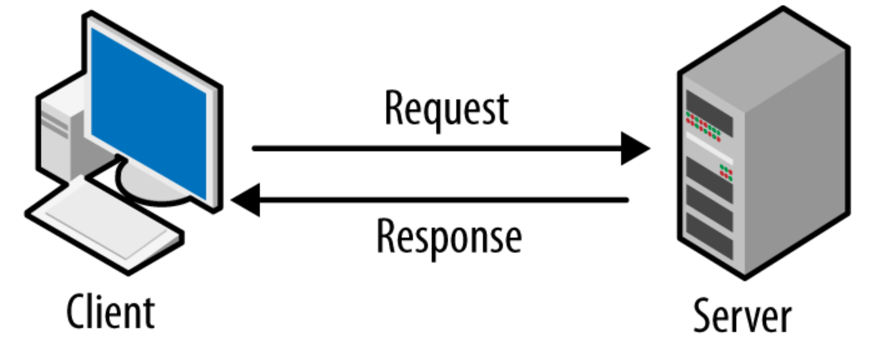
Fetch API Request
fetch('https://hello.free.beeceptor.com')
.then(response => response.json())
.then(data => console.log(data));
Here we are fetching a JSON file across the network and printing it to the console.
The endpoint does not directly return the JSON response body but instead returns a promise that resolves with a Response object.

Slide 18
Fetch API
const url = "https://jsonplaceholder.typicode.com/todos/16";
fetch(url) .then(data => data.json()) .then((json) => { alert(JSON.stringify(json));
//document.getElementById("geo2").innerHTML = JSON.stringify(json);
})

Slide 19
FREE API MOCKUP WEBSITE
Beeceptor - Zero Coding Rest API Mocking - Rest API Mock Server
JSONPlaceholder - Free Fake REST API (typicode.com)
The first GitHub App for Mocking REST/GraphQL API (mockend.com)
You can use these websites to simulate or create a generic API request

Slide 20
REST API POST Method
const url2 = 'https://jsonplaceholder.typicode.com/todos/10';
const data = { title: "The Matrix", year: "1994" }; fetch( url2, { headers: { "Content-Type": "application/json" }, body: JSON.stringify(data), method: "POST" } )
.then(data => data.json()) .then((json) => { alert(JSON.stringify(data));
document.getElementById("geo3").innerHTML = JSON.stringify(data); });
we're calling fetch() with two arguments: url and options(headers, body, and method).
The header we need to set is Content-Type, and the value is application/json. That takes care of our API knowing that it's receiving JSON data.

Slide 21
Checking if the fetch was successful
fetch('https://cdn.pixabay.com/photo/2016/11/29/06/17/audience-1867754_960_720.jpg')
.then(response => {
if (!response.ok) {
throw new Error('Network response was not OK');
}
return response.blob();
})
.then(myBlob => {
myImage.src = URL.createObjectURL(myBlob);
})
.catch(error => {
console.error('There has been a problem with your fetch operation:', error);
});

Slide 22
Old Version of REST-API ( XMLHttpRequest)
const request = new XMLHttpRequest();
const url = 'https://jsonplaceholder.typicode.com/todos/16';
request.open("GET", url);
request.send();
request.onload = (e) => {
alert(request.response);
//document.getElementById("canvas").innerHTML = request.response;
}

Slide 23
Activity
Use Fetch and XML to make API requests to any URL of your choice.
Create your API in Beeceptor and make a fetch request.

Slide 24

Publish a website
There are two methods of publishing a website.
I. Purchase a domain
Ii. Publish in third party providers
Steps involved in hosting a website.

Slide 25
Domain Route
To have more control over content and website appearance, you buy domain name and host your website.
Web hosting is about renting file space from a hosting company's web server. You put website files on the web server. The web server provides website content to website visitors.
A domain name is the unique address where people find your website, such as
https://www.mozilla.org
The Latest News from the UK and Around the World | Sky News

Slide 26
Paid Domains (Website Hosting)
Examples of paid domains, visit the links and follow the instructions:
Deploy a website to Azure with Azure App Service learning path - Learn | Microsoft Docs
Build Free Websites and Webapps (amazon.com)
Buy your Domain Name today with names.co.uk!
Domain name registration and web hosting services | 123 Reg (123-reg.co.uk)
Domain Name Search - Check Availability & Registration (shopify.co.uk)
Domain Names, Websites, Hosting & Online Marketing Tools - GoDaddy UK
Web Hosting | Google Cloud

Slide 27


Open Source or Free Hosting
There are several free hosting sites, but we will concentrate on two:
Github
Netlify

Slide 28
GITHUB Website Hosting
Signup on Github verify your email address.
Create a repository to store files (HTML, CSS & JS).
On this page, in the Repository name box, enter username.github.io, where username is your username e.g jamesbond.github.io
Drag and drop the content and click commit changes.
Note: Make sure your folder has an index.html file.
5. Go to settings, click pages and change source to master and save.
6. Your site is ready, navigate your browser and paste the provided github link e.g chrisdavidmills.github.io.

Slide 29
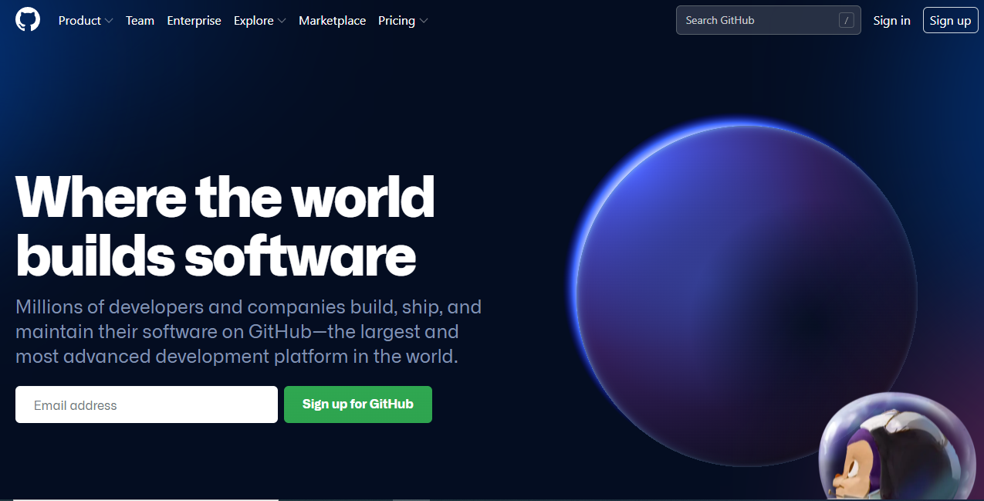
Signup on Github and Verify Your Email

Slide 30
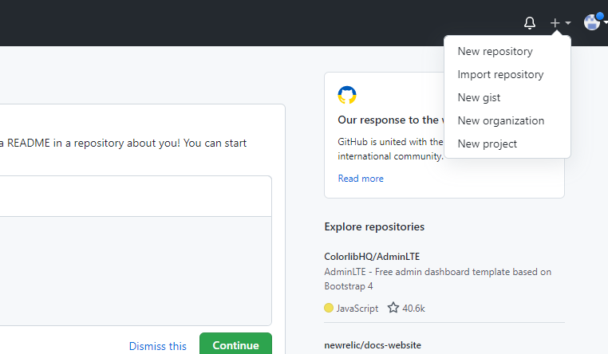
Create a repository

Slide 31
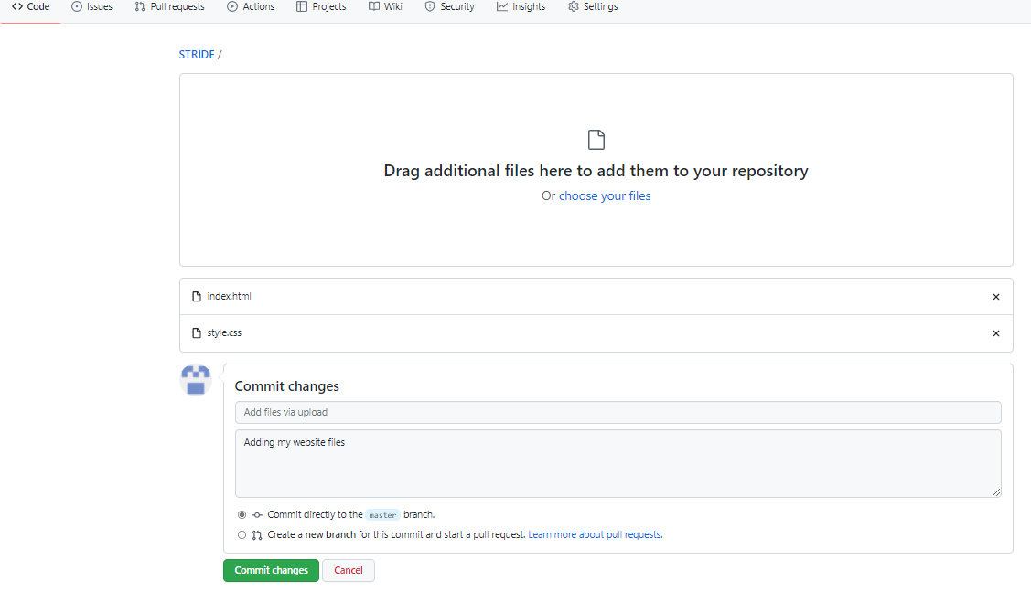
Drag and drop your files, then commit

Slide 32
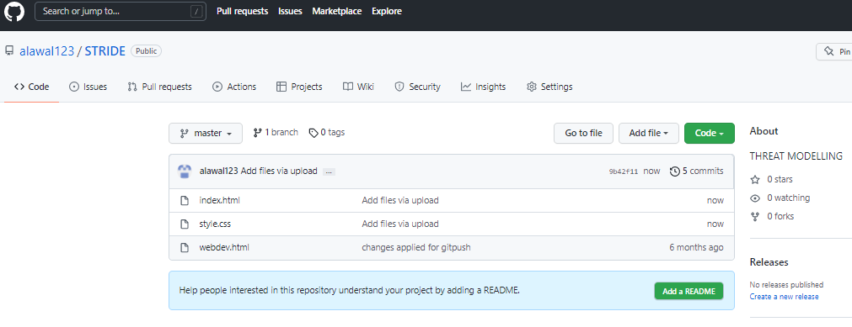
After Adding my Files

Slide 33
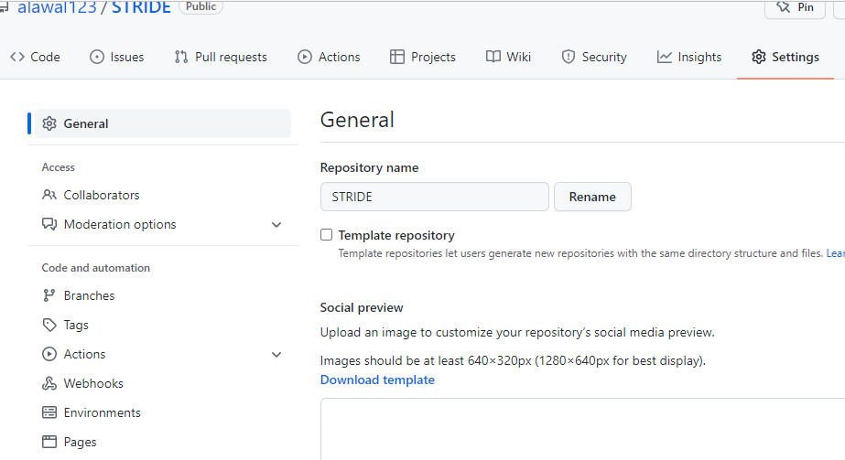
Go to settings and click Pages

Slide 34
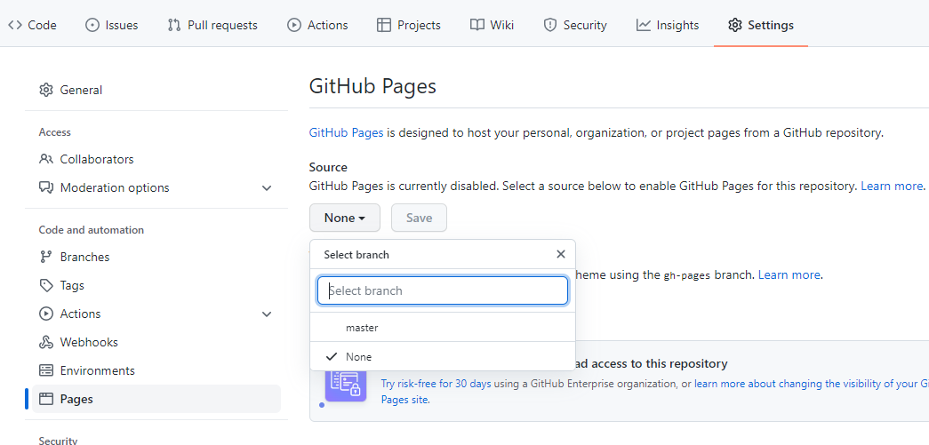
On the Github pages
Change the source from none to master.

Slide 35
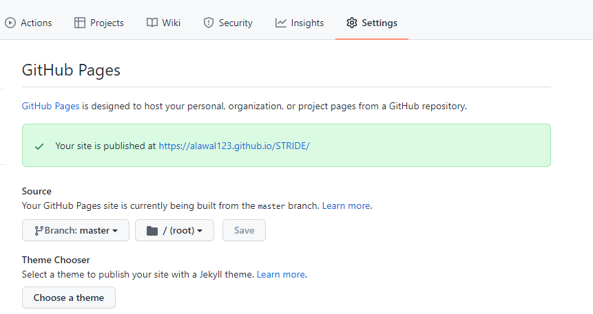
Published Link
Your link will be active in 3 minutes, copy the link and paste in your browser.

Slide 36
Activity
Publish your first semester assignment using github pages.

Slide 37
Take home Activity 2
Follow the steps in Netlify and publish your website.
A Step-by-Step Guide: Deploying on Netlify

